Slide 1

Chatbot Agent
Santander | Ago 25

Slide 2
What this agent does
Exposes a REST API so Santander customers can create conversations and exchange messages.
Primary conversational interaction endpoint: POST /conversations/{conversation_id}/messages.
All conversation state and user–LLM interactions are stored in a DynamoDB table.
Inference & orchestration built with LangGraph; LLM can be selected per deployment (Bedrock or OpenAI).
Optional features per request: deep link detection, and follow‑up suggestions.

Slide 3
Request flow (happy path)
Client calls POST /conversations to create a conversation (returns conversation_id).
Client sends POST /conversations/{conversation_id}/messages with the user message.
FastAPI validates request, loads conversation context from DynamoDB.
Agent executes via LangGraph:
empty_initial is the starting point of the graph, if the agent only have one KnowledgeBase and this is the first interaction with the customer, it tries to get information from the KnowledgeBase in first place
tool runs any tool, actually only the KnowlegeBase is supported
chatbot calls the selected LLM to generate the assistant reply.
check_cc_redirect checks for escalation intent; if positive, return redirect response and ignore other LLM outputs.
deep_link_invoke detects configured deep links in user intent.
suggestions (if requested) returns follow‑up queries.
Agent writes interaction + updated state to DynamoDB.
API responds with assistant reply + any deep links / suggestions / redirect flags.

Slide 4
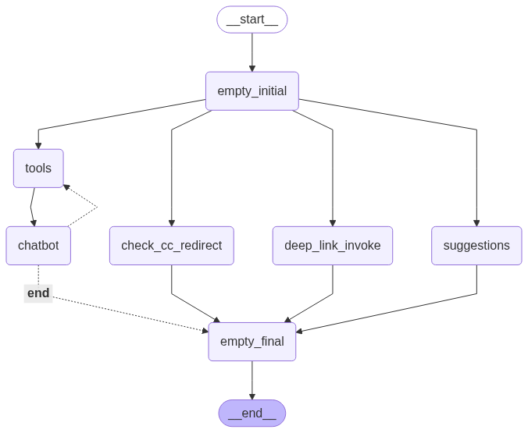
LangGraph Topology

Slide 5
LangGraph nodes – responsibilities
empty_initial: Start node; if there’s a single KnowledgeBase and this is the first turn, fetch KnowledgeBase documents first.
tools: Execute tools (currently KnowledgeBase only).
chatbot: Main LLM call; model chosen per deployment (Bedrock/OpenAI).
check_cc_redirect: LLM-based intent detection to escalate to a human if appropriate; overrides other outputs.
deep_link_invoke: LLM-based detection of configured deep links based on user intent.
suggestions: Optional; LLM proposes next queries relevant to the current context.
empty_final: Barrier/convergence node to collect parallel LLM/tool outputs.

Slide 6
API surface (minimum)
POST /conversations – create conversation; returns { conversation_id }.
POST /conversations/{conversation_id}/messages – send a user message and get agent response.
Query params/flags (example): suggestions=true to request follow‑ups in the response.
Responses include: assistant message, optional deep links, optional suggestions, optional escalation flag.

Slide 7
DynamoDB data model
Interactions table (e.g., prod-us-chatbot-interactions):
PK: conversationId, SK: messageId.
Items: conversation metadata, messages (role, text, tokens, model, tool calls), suggestions, deeplinks, flags, customer feedback.
Sessions table ( e.g., prod-us-chatbot-sessions):
PK: sessionId
Items: each customer session information (channel, …)
GSIs:
clientId-conversationId-index on Interactions table on clientId and conversationId for listing conversations per customer.

Slide 8
Security & compliance
It uses the ODS microservices architecture, approved for the deployment in all the companies.
Encrypt at rest and in transit (TLS 1.2+).
Bedrock Guardrails configured

Slide 9
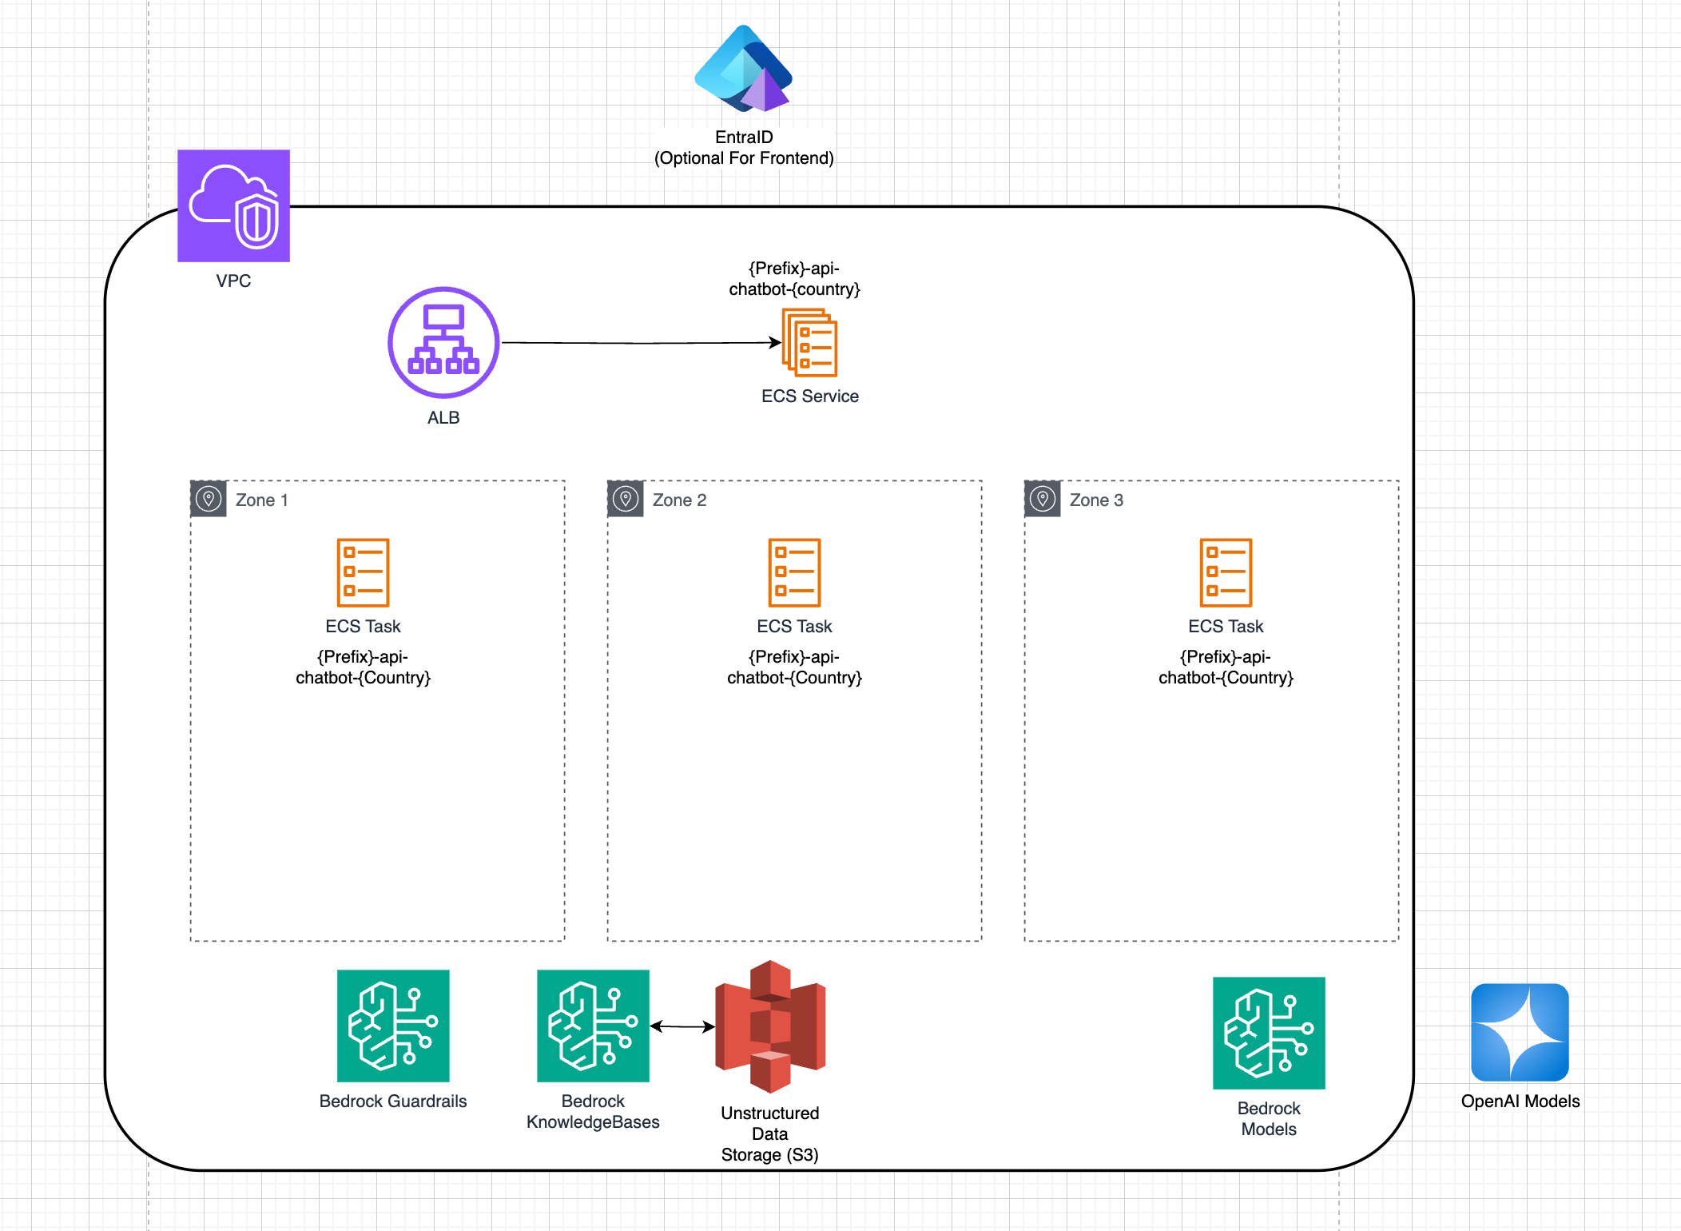
Technical Architecture

Slide 10
Technical Architecture
We deploy the microservice in AWS, using the services:
AWS Load Balancer: As an entry point for the API
AWS ECS: For the containers management, containers are deployed in three availability zones in production
AWS Bedrock Guardrails: For the conversation security, the specific security measures can be adapter per implementation
AWS Bedrock KnowledgeBases: For the knowledge base generation and management. It connects to S3 to get the documents, and with Neptune Graph to store the Graph RAG and vectors of embeddings
The chatbot can use models from AWS Bedrock or OpenAI

Slide 11
Technical Architecture
A Frontend can be activated to interact with the API
If the Frontend is activated, automatically the frontend and API are protected with an integration with EntraID, using OIDC
The frontend is exposed in the same microservice and URL than the API

Slide 12
Configuration management
All the configuration of the microservice is managed using Pydantic Settings, storing the configuration elements in AWS Parameter Store
When the microservice is launched, it reads the parameter values from parameter store and configure the application

Slide 13
Monitoring
The infrastructure is monitored using CloudWatch metrics, where we have all the information about the performance metrics
The microservice is integrated with Dynatrace to send all the information of the API calls and integrations
There is also an integration with Arize Phoenix, deployed centrally in the AI platform, where we analyze the interactions and produce KPI dashboards to report all the AI activity of the Group
In Phoenix we generate also metrics related with the Hallucination, Q&A Correctness and Relevance

Slide 14
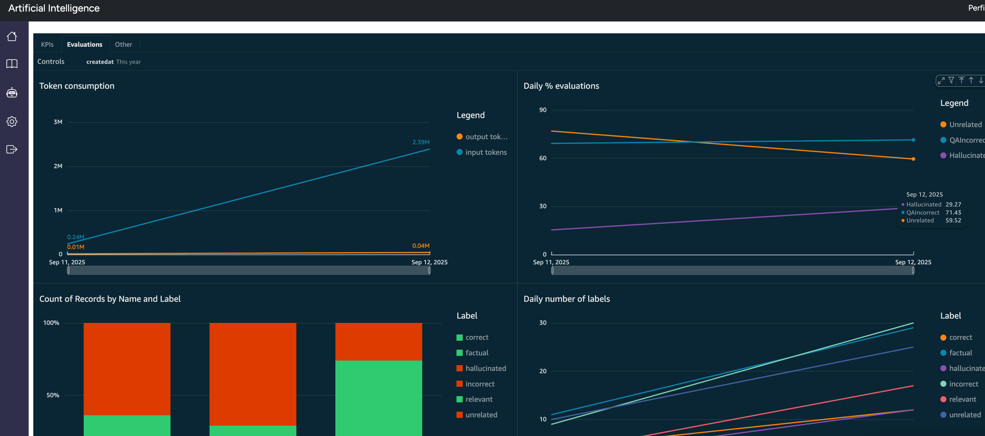
Monitoring
For the metrics in Phoenix, we produce the evaluation using a technique called LLM as a Judge
We evaluate a percentage of all the interactions, and produce dashboards in AITool

Slide 15
Deployment
The deployment of the infrastructure is done by the global AI Team, they deploy the platform and operate it later.
All the deployments are done in the Grupo Santander Regional Landing Zone, using accounts owned by the final entity
Exceptionally, it can be deployed in a different Landing Zone, but a plan for the migration to the global landing zone should be provided.

Slide 16
Knowledge Bases Management
There are two models for the information management in the Knowledge Base:
Manage the KB from the AITool (more information in the AITool documentation), this model allows more control on the deployment process and information reaching to the production system
Automatic synchronization with different sources, for example Sharepoint. This model allows a more flexible environment, where the business team can manage the information in Sharepoint (for example) and the information is replicated automatically

Slide 17
Knowledge Bases Management
For the Synchronization we’ve created a component (docker ECS Task), this task is scheduled using AWS EventBridge Scheduler, and synchronizes the source with the S3 bucket
This process can also take information from the source and store it as metadata in the Knowledge Base
The metadata can be used later in the chatbot as a filter for the queries, this is a mechanism to filter the information a user can query

Slide 18
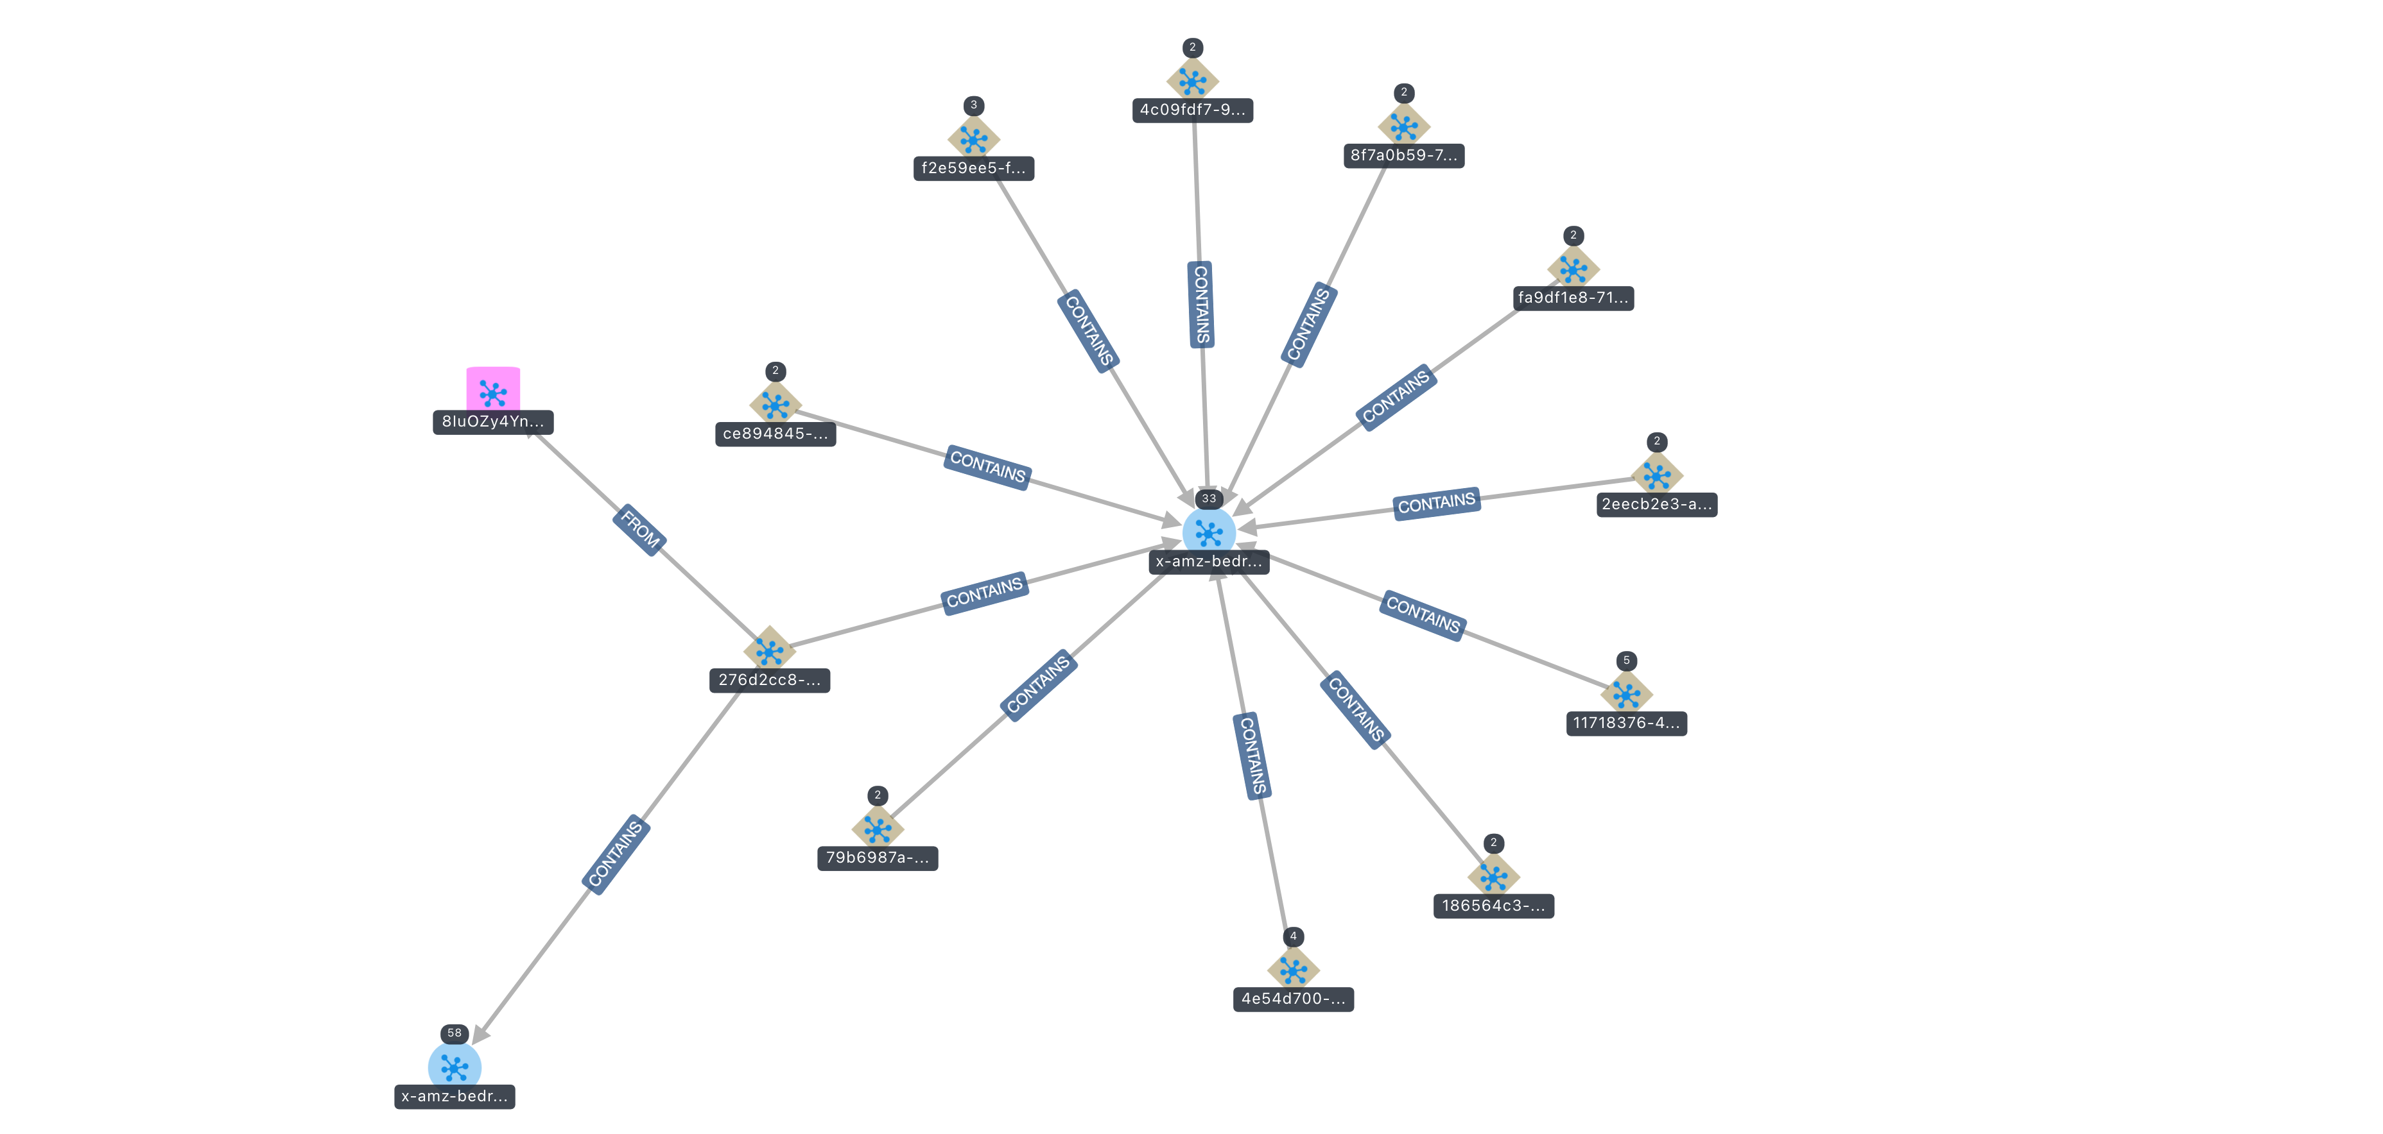
Knowledge Base Graph RAG
The Knowledge Base generates a Graph RAG in Neptune Analytics
The Graph RAG allows the search of information not only based on the vector of embeddings, but also based on the semantic proximity of the concepts

